Slide 1
Sample UP artifacts and timing
Discipline | Artifact | Incep. | Elab. | Const. | Trans.
 | Iteration | I1 | E1..En | C1..Cn | T1..T2
Business Modeling | Domain Model |  | s
Requirements | Use-Case Model | s | r
 | Vision | s | r
 | Supplementary Specification | s | r
 | Glossary | s | r
Design | Design Model |  | s | r
 | SW Architecture Document |  | s
s - start; r - refine

Slide 2
Three Common Use Case Formats
Brief Terse one-paragraph summary, usually of the main success scenario. The prior Process Sale example was brief.
Casual Informal paragraph format. Multiple paragraphs that cover various scenarios. The prior Handle Returns example was casual.
Fully dressed All steps and variations are written in detail, and there are supporting sections, such as preconditions and success guarantees

Slide 3
How to Find Use Cases
Choose the system boundary.
Identify the primary actors
Identify the goals for each primary actor.
Define use cases that satisfy user goals

Slide 4
Primary actor
  To find user goals, which drive the use cases.
Supporting actor
  To clarify external interfaces and protocols.
Offstage actor for example, a government tax agency.
  To ensure that all necessary interests are identified and satisfied. Offstage actor interests are sometimes subtle or easy to miss unless these actors are explicitly named.

Slide 5
Actor-Goal Model
Actor | Goal |  | Actor | Goal
Cashier | process sales process rentals handle returns cash in cash out … |  | System Administrator | add users modify users delete users manage security manage system tables …
Manager | start up shut down … |  | Sales Activity System | analyze sales and performance data

Slide 6
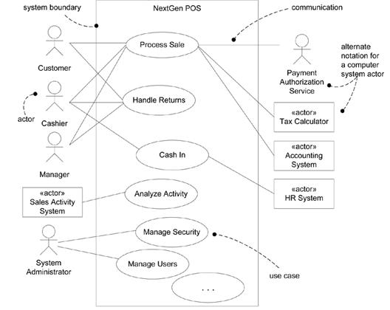
Use-Case Model

Slide 7
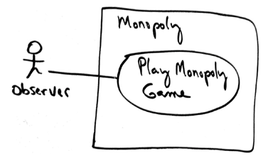
Monopoly Game

Slide 8
Use Case UC1: Play Monopoly Game
Scope: Monopoly application
Level: user goal
Primary Actor: Observer
Stakeholders and Interests:
  Observer: Wants to easily observe the output of the game simulation.

Slide 9
Main Success Scenario:
Observer requests new game initialization, enters number of players.
Observer starts play.
System displays game trace for next player move (see domain rules, and "game trace" in glossary for trace details).
Repeat step 3 until a winner or Observer cancels.

Slide 10
Extensions:
*a. At any time, System fails:
(To support recovery, System logs after each completed move)
  Observer restarts System.
  System detects prior failure, reconstructs state, and prompts to continue.
  Observer chooses to continue (from last completed player turn).
Special Requirements:
  Provide both graphical and text trace modes.

Slide 11
Sample UP artifacts and timing
Discipline | Artifact | Incep. | Elab. | Const. | Trans.
 | Iteration | I1 | E1..En | C1..Cn | T1..T2
Business Modeling | Domain Model |  | s
Requirements | Use-Case Model | s | r
 | Vision | s | r
 | Supplementary Specification | s | r
 | Glossary | s | r
Design | Design Model |  | s | r
 | SW Architecture Document |  | s
s - start; r - refine

Slide 12
Use Cases in the NextGen Inception Phase
Fully Dressed | Casual | Brief
Process Sale Handle Returns | Process Rental Analyze Sales Activity Manage Security … | Cash In Cash Out Manage Users Start Up Shut Down Manage System Tables

Slide 13
Other Requirement Artifacts
Supplementary Specification
  captures and identifies other kinds of requirements, such as reports, documentation, packaging, supportability, licensing, and so forth.
Glossary
  captures terms and definitions; it can also play the role of a data dictionary.
Vision
  summarizes the "vision" of the project an executive summary. It serves to tersely communicate the big ideas.
Business Rules (or Domain Rules)
  capture long-living and spanning rules or policies, such as tax laws, that transcend one particular application.

Slide 14
Term | Definition and Information | Format | Validation Rules | Aliases
item | A product or service for sale
payment authorization | Validation by an external payment authorization service that they will make or guarantee the payment to the seller.
payment authorization request | A composite of elements electronically sent to an authorization service, usually as a char array. Elements include: store ID, customer account number, amount, and timestamp.
UPC | Numeric code that identifies a product. Usually symbolized with a bar code placed on products. See www.uc-council.org for details of format and validation. | 12-digit code of several subparts. | Digit 12 i s a check digit. | Universal Product Code

Slide 15
Term attributes could include:
aliases
description
format (type, length, unit)
relationships to other elements
range of values
validation rules

Slide 16
ID | Rule | Changeability | Source
RULE1 | Signature required for credit payments. | Buyer "signature" will continue to be required, but within 2 years most of our customers want signature capture on a digital capture device, and within 5 years we expect there to be demand for support of the new unique digital code "signature" now supported by USA law. | The policy of virtually all credit authorization companies.
RULE2 | Tax rules. Sales require added taxes. See government statutes for current details. | High. Tax laws change annually, at all government levels. | law
RULE3 | Credit payment reversals may only be paid as a credit to the buyer's credit account, not as cash. | Low | credit authorization company policy

Slide 17
Discipline | Artifact | Incep. | Elab. | Const. | Trans.
 | Iteration | I1 | E1..En | C1..Cn | T1..T2
Business Modeling | Domain Model |  | s
Requirements | Use-Case Model | s | r
 | Vision | s | r
 | Supplementary Specification | s | r
 | Glossary | s | r
 | Business Rules | s | r
Design | Design Model |  | s | r
 | SW Architecture Document |  | s
 | Data Model |  | s | r

Slide 18
Elaboration

Slide 19
The requirements for the first iteration of the NextGen POS application
Implement a basic, key scenario of the Process Sale use case: entering items and receiving a cash payment.
Implement a Start Up use case as necessary to support the initialization needs of the iteration.
Nothing fancy or complex is handled, just a simple happy path scenario, and the design and implementation to support it.
There is no collaboration with external services, such as a tax calculator or product database.
No complex pricing rules are applied.

Slide 20
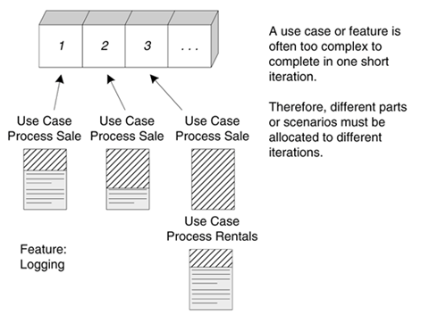
Use case implementation may be spread across iterations

Slide 21
On to Elaboration
the core, risky software architecture is programmed and tested
the majority of requirements are discovered and stabilized
the major risks are mitigated or retired
Build the core architecture, resolve the high-risk elements, define most requirements, and estimate the overall schedule and resources.

Slide 22
What Artifacts May Start in Elaboration?
Artifact | Comment
Domain Model | This is a visualization of the domain concepts; it is similar to a static information model of the domain entities.
Design Model | This is the set of diagrams that describes the logical design. This includes software class diagrams, object interaction diagrams, package diagrams, and so forth.
Software Architecture Document | A learning aid that summarizes the key architectural issues and their resolution in the design. It is a summary of the outstanding design ideas and their motivation in the system.
Data Model | This includes the database schemas, and the mapping strategies between object and non-object representations.
Use-Case Storyboards, UI Prototypes | A description of the user interface, paths of navigation, usability models, and so forth.

Slide 23
Planning the Next Iteration
Risk
  includes both technical complexity and other factors, such as uncertainty of effort or usability.
Coverage
  implies that all major parts of the system are at least touched on in early iterations perhaps a "wide and shallow" implementation across many components.
Criticality
  refers to functions the client considers of high business value.

Slide 24
Rank | Requirement (Use Case or Feature) | Comment
High | Process Sale Logging … | Scores high on all rankings. Pervasive. Hard to add late. …
Medium | Maintain Users … | Affects security subdomain. …
Low | … | …

Slide 25
Alan Modeli
(Domain Model)

Slide 26
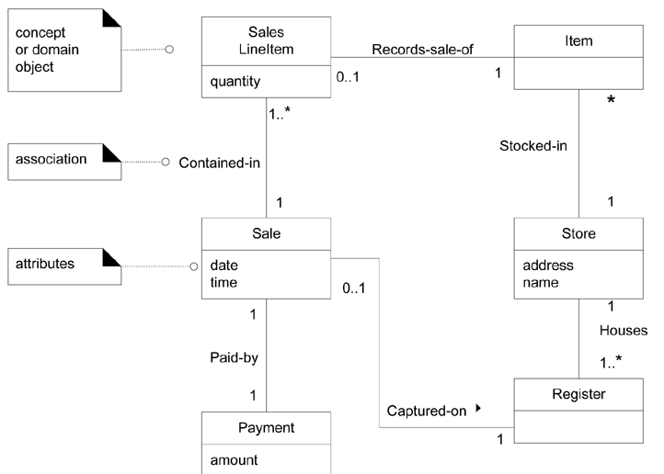
A Sample Domain Model

Slide 27
The Elements of Domain Model
Domain objects or conceptual classes
Associations between conceptual classes
Attributes of conceptual classes

Slide 28

Domain model shows real-situation conceptual classes, not software classes

Slide 29
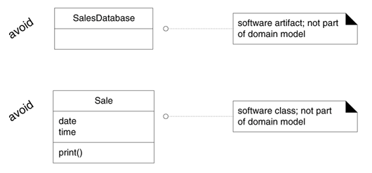
A domain model does not show software artifacts or classes

Slide 30
What are Conceptual Classes?
Symbol words or images representing a conceptual class.
Intension the definition of a conceptual class.
Extension the set of examples to which the conceptual class applies.

Slide 31
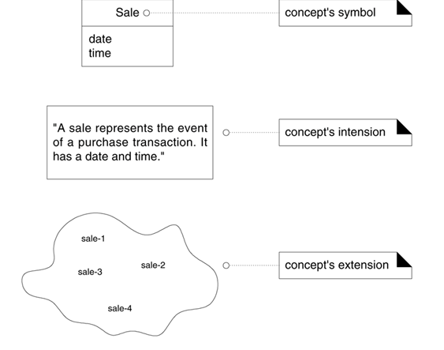
A conceptual class has a symbol, intension, and extension

Slide 32
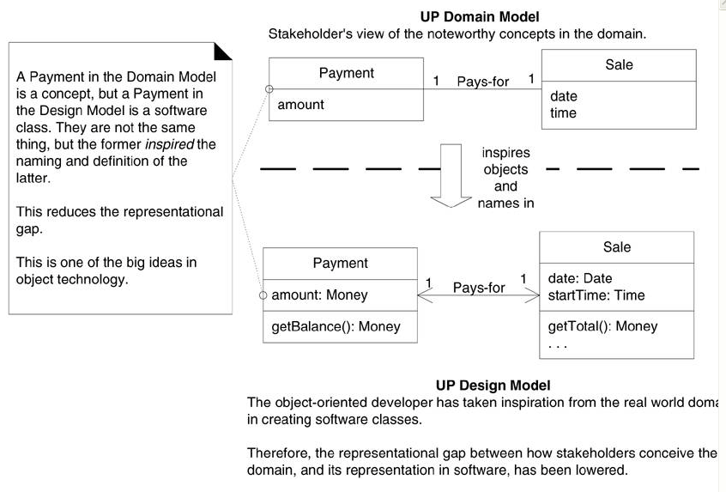
Lower representational gap with OO modeling

Slide 33
How to Create a Domain Model?
Find the conceptual classes
Draw them as classes in a UML class diagram.
Add associations and attributes.

Slide 34
Three Strategies to Find Conceptual Classes
Reuse or modify existing models.
Use a category list.
Identify noun phrases.

Slide 35
Conceptual Class Category List
Conceptual Class Category | Examples
business transactions Guideline: These are critical (they involve money), so start with transactions. | Sale, Payment Reservation
transaction line items Guideline: Transactions often come with related line items, so consider these next. | SalesLineItem
product or service related to a transaction or transaction line item Guideline: Transactions are for something (a product or service). Consider these next. | Item Flight, Seat, Meal
where is the transaction recorded? Guideline: Important. | Register, Ledger FlightManifest

Slide 36
roles of people or organizations related to the transaction; actors in the use case Guideline: We usually need to know about the parties involved in a transaction. | Cashier, Customer, Store MonopolyPlayer Passenger, Airline
place of transaction; place of service | Store Airport, Plane, Seat
noteworthy events, often with a time or place we need to remember | Sale, Payment MonopolyGame Flight
physical objects Guideline: This is especially relevant when creating device-control software, or simulations. | Item, Register Board, Piece, Die Airplane
descriptions of things | ProductDescription FlightDescription

Slide 37
Catalogs Guideline: Descriptions are often in a catalog. | ProductCatalog FlightCatalog
containers of things (physical or information) | Store, Bin Board Airplane
things in a container | Item Square (in a Board) Passenger
other collaborating systems | CreditAuthorizationSystem AirTrafficControl
records of finance, work, contracts, legal matters | Receipt, Ledger MaintenanceLog
financial instruments | Cash, Check, LineOfCredit TicketCredit
schedules, manuals, documents that are regularly referred to in order to perform work | DailyPriceChangeList RepairSchedule

Slide 38
Finding Conceptual Classes with Noun Phrase Identification -1
1. Customer arrives at a POS checkout with goods and/or services to purchase.
2. Cashier starts a new sale.
3. Cashier enters item identifier.
4. System records sale line item and presents item description, price, and running total. Price calculated from a set of price rules.
Cashier repeats steps 2-3 until indicates done.
5. System presents total with taxes calculated.

Slide 39
Finding Conceptual Classes with Noun Phrase Identification -2
6. Cashier tells Customer the total, and asks for payment.
7. Customer pays and System handles payment.
8. System logs the completed sale and sends sale and payment information to the external Accounting (for accounting and commissions) and Inventory systems (to update inventory).
9. System presents receipt.
10. Customer leaves with receipt and goods (if any).

Slide 40
Concepts in the POS Domain
Sale | Cashier
CashPayment | Customer
SalesLineItem | Store
Item | ProductDescription
Register | ProductCatalog
Ledger

Slide 41
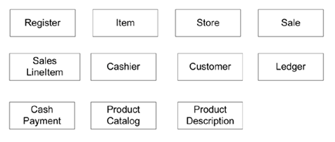
Initial POS domain model

Slide 42


Attributes vs. Classes
If we do not think of some conceptual class X as a number or text
in the real world, X is probably a conceptual class, not an attribute.

Slide 43
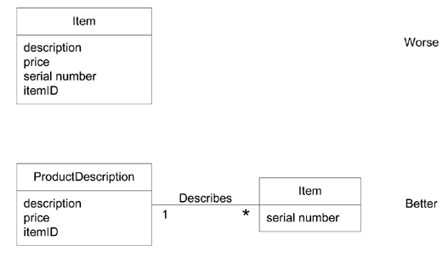
Why Use 'Description' Classes?

Slide 44
When Are Description Classes Useful?
There needs to be a description about an item or service, independent of the current existence of any examples of those items or services.
Deleting instances of things they describe (for example, Item) results in a loss of information that needs to be maintained, but was incorrectly associated with the deleted thing.
It reduces redundant or duplicated information.

Slide 45
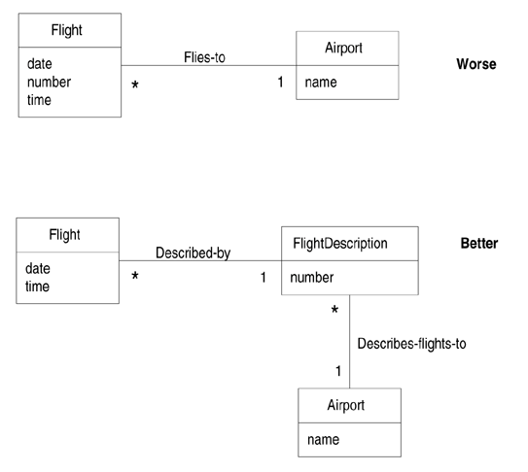
Descriptions about other things

Slide 46
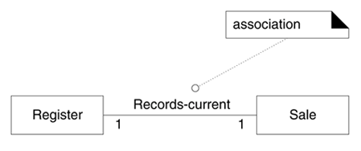
Associations

Slide 47
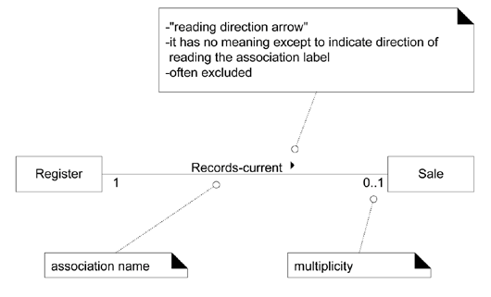
The UML notation for associations

Slide 48
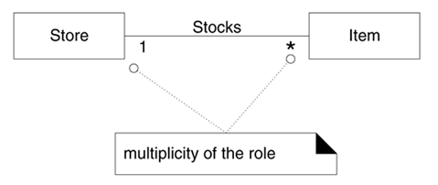
Multiplicity on an association

Slide 49
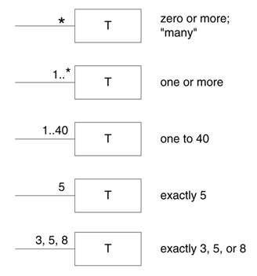
Multiplicity values

Slide 50
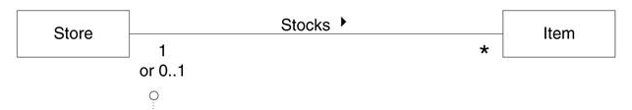
Multiplicity is context dependent

Slide 51
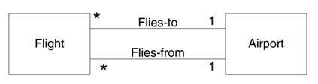
Multiple associations

Slide 52
Common Associations List
Category | Examples
A is a transaction related to another transaction B | CashPaymentSale CancellationReservation
A is a line item of a transaction B | SalesLineItemSale
A is a product or service for a transaction (or line item) B | ItemSalesLineItem (or Sale) FlightReservation
A is a role related to a transaction B | CustomerPayment PassengerTicket
A is a physical or logical part of B | DrawerRegister SquareBoard SeatAirplane
A is physically or logically contained in/on B | RegisterStore, ItemShelf SquareBoard PassengerAirplane

Slide 53
A is a description for B | ProductDescriptionItem FlightDescriptionFlight
A is known/logged/recorded/reported/captured in B | SaleRegister PieceSquare ReservationFlightManifest
A is a member of B | CashierStore PlayerMonopolyGame PilotAirline

Slide 54
A is an organizational subunit of B | DepartmentStore MaintenanceAirline
A uses or manages or owns B | CashierRegister PlayerPiece PilotAirplane
A is next to B | SalesLineItemSalesLineItem SquareSquare CityCity

Slide 55
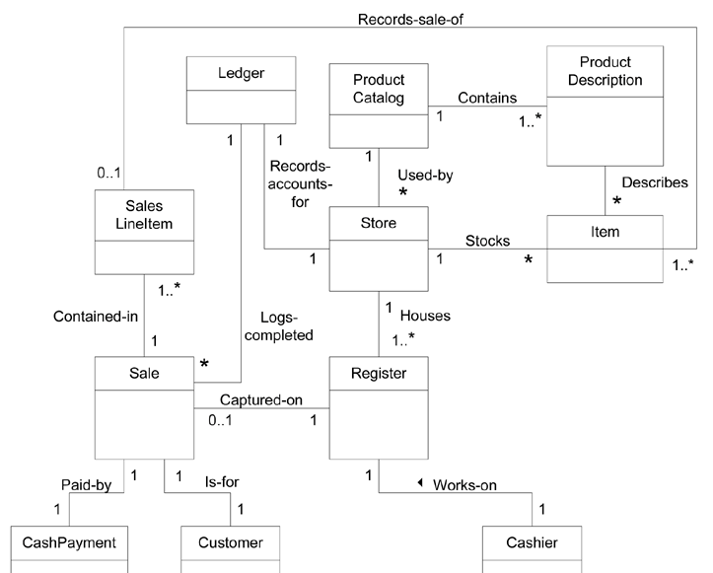

Slide 56
When to Show Attributes?
A receipt in the Process Sale use case normally includes a date and time, the store name and address, and the cashier ID, among many other things.
Sale needs a dateTime attribute.
Store needs a name and address.
Cashier needs an ID.

Slide 57
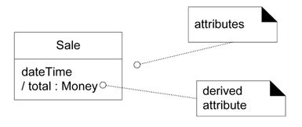
Class and attributes

Slide 58
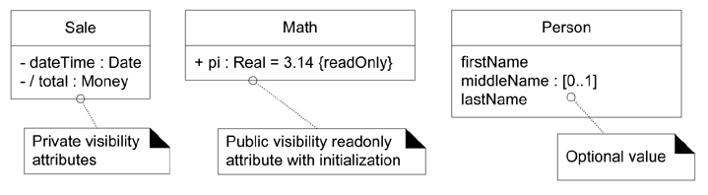
Attribute notation in UML

Slide 59
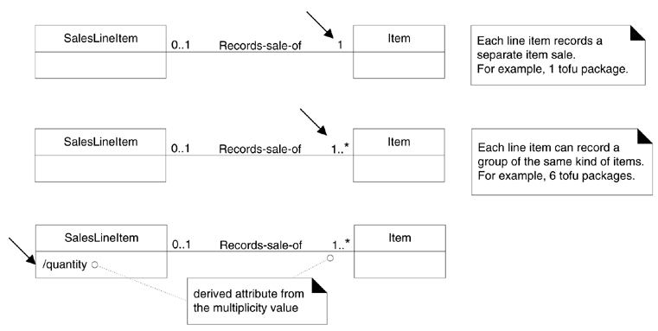

Slide 60
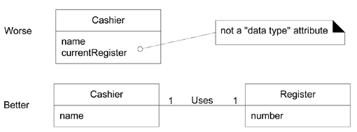
Relate with associations, not attributes

Slide 61
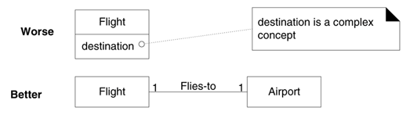
Don't show complex concepts as attributes; use associations

Slide 62
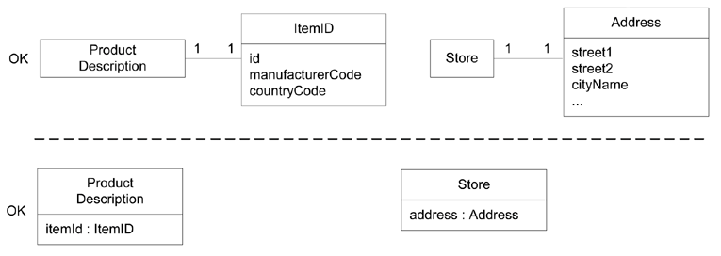
Two ways to indicate a data type property of an object

Slide 63
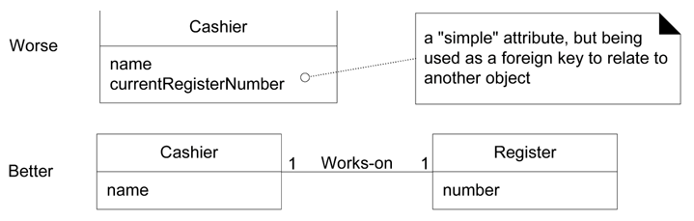
No Attributes Representing Foreign Keys

Slide 64
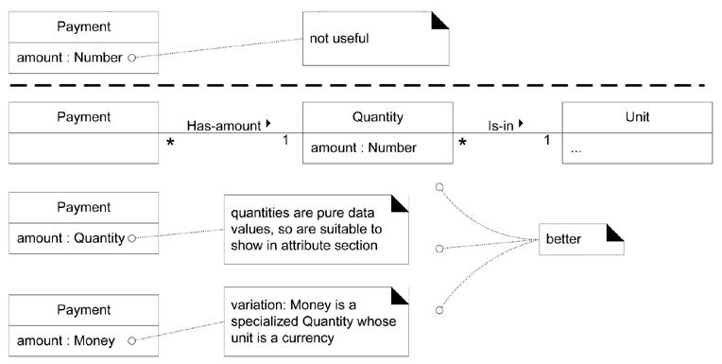
Modeling Quantities and Units

Slide 65
Attributes in the Domain Models of NextGen POS
CashPayment | amountTendered To determine if sufficient payment was provided, and to calculate change, an amount (also known as "amount tendered") must be captured.
Product-Description | description To show the description on a display or receipt. itemId To look up a ProductDescription. price To calculate the sales total, and show the line item price.
Sale | dateTime A receipt normally shows date and time of sale, and this is useful for sales analysis.
SalesLineItem | quantity To record the quantity entered, when there is more than one item in a line item sale (for example, five packages of tofu).
Store | address, name The receipt requires the name and address of the store.

Slide 66
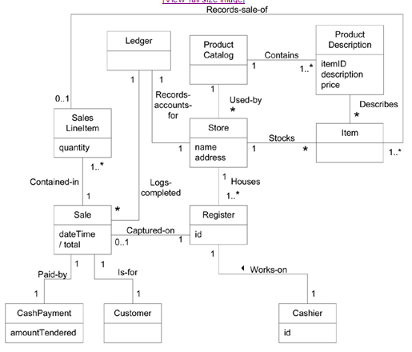

Slide 67
Domain Models Within the UP
Discipline | Artifact | Incep. | Elab. | Const. | Trans.
 | Iteration | I1 | E1..En | C1..Cn | T1..T2
Business Modeling | Domain Model |  | s
Requirements | Use-Case Model (SSDs) | s | r
 | Vision | s | r
 | Supplementary Specification | s | r
 | Glossary | s | r
Design | Design Model |  | s | r
 | SW Architecture Document |  | s
 | Data Model |  | s | r

